Slide 1
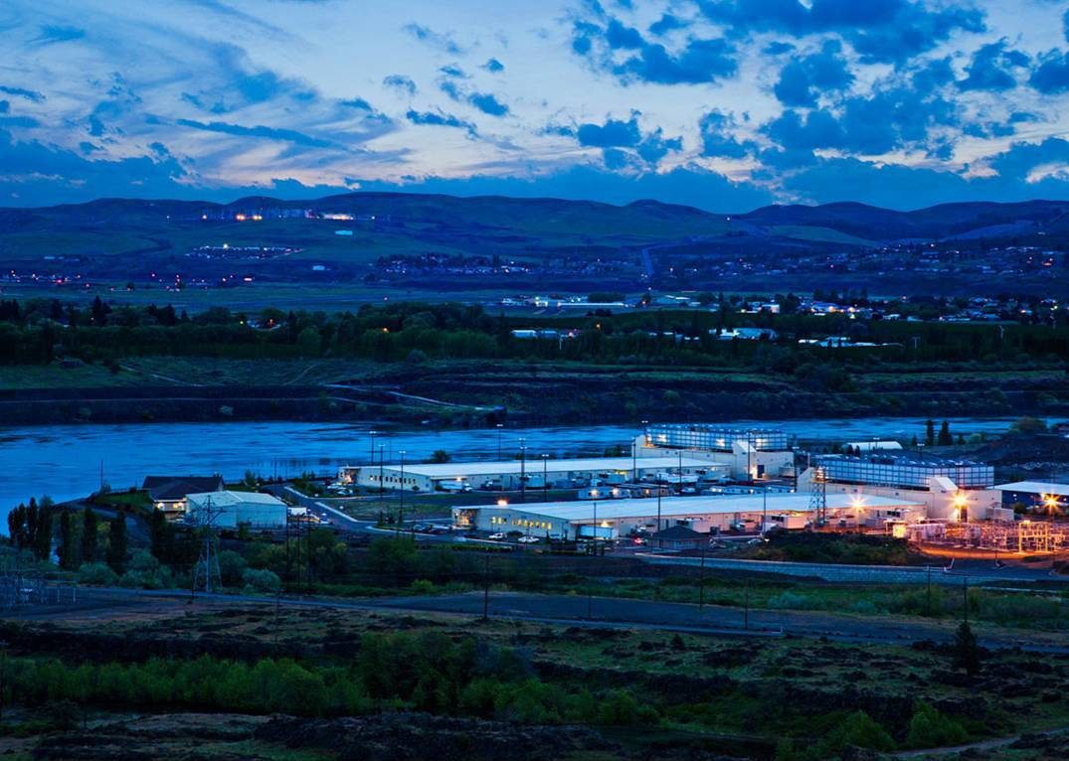
Visiting one of the Google Data Centers in 10 slides
Dalles, Oregon on the banks of the Columbia River

Slide 2
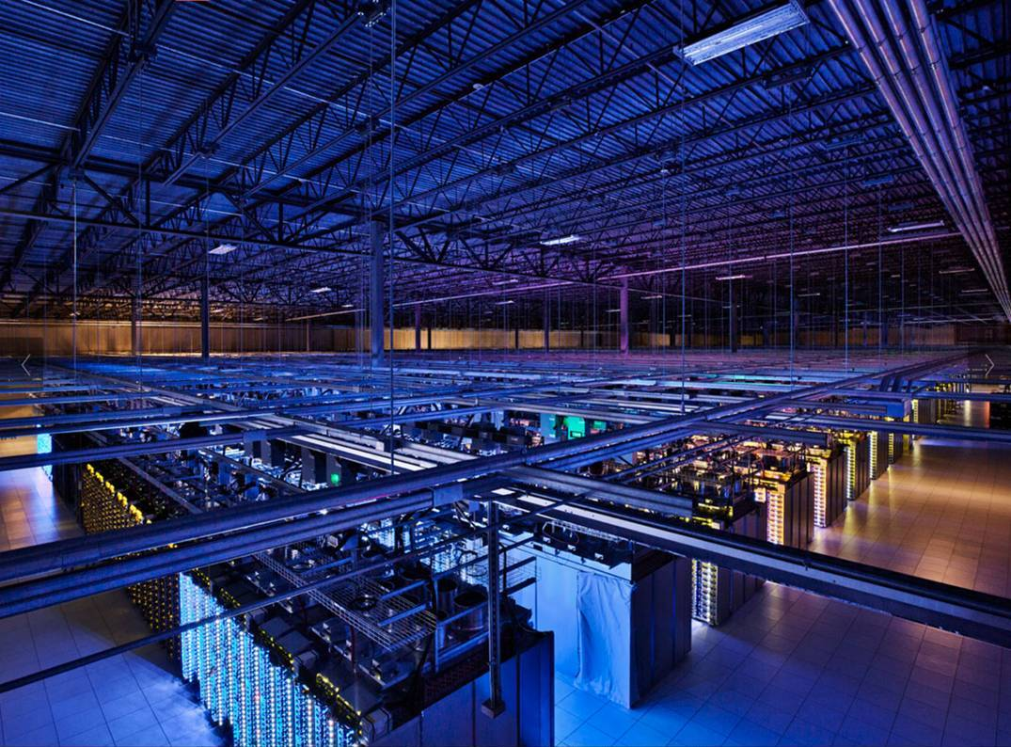
A google engine room : more than 10000 m²

Slide 3
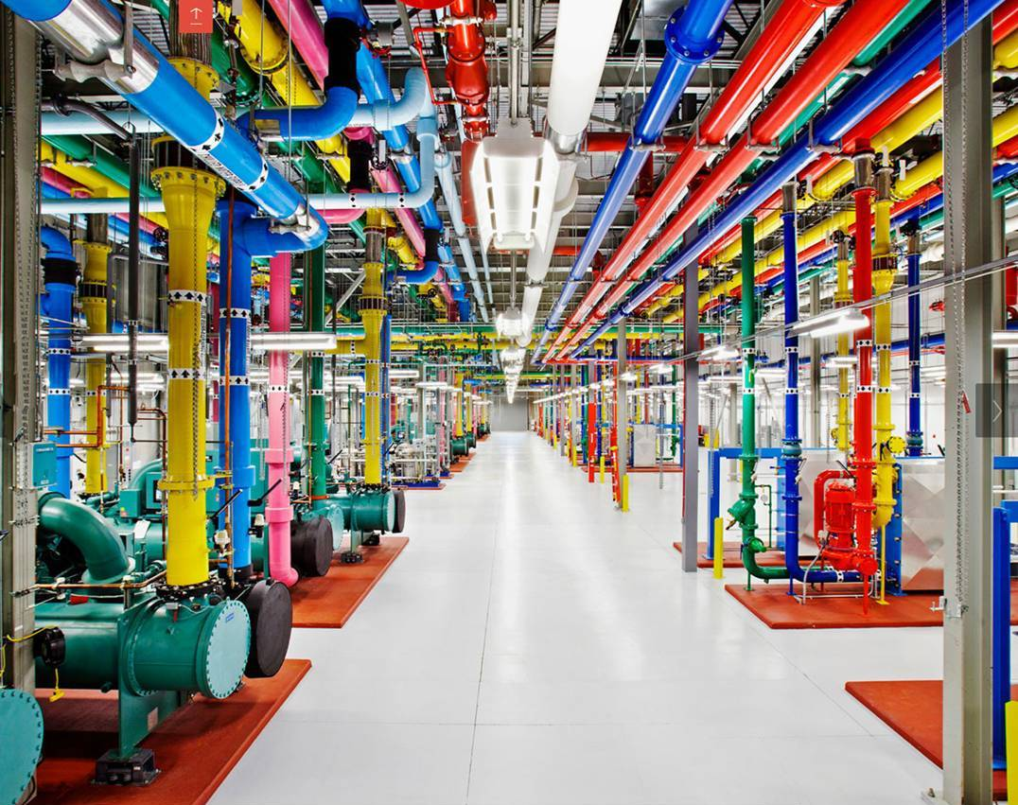
Cooling: Richly colored
The color of the pipes indicates the direction of flow.

Slide 4
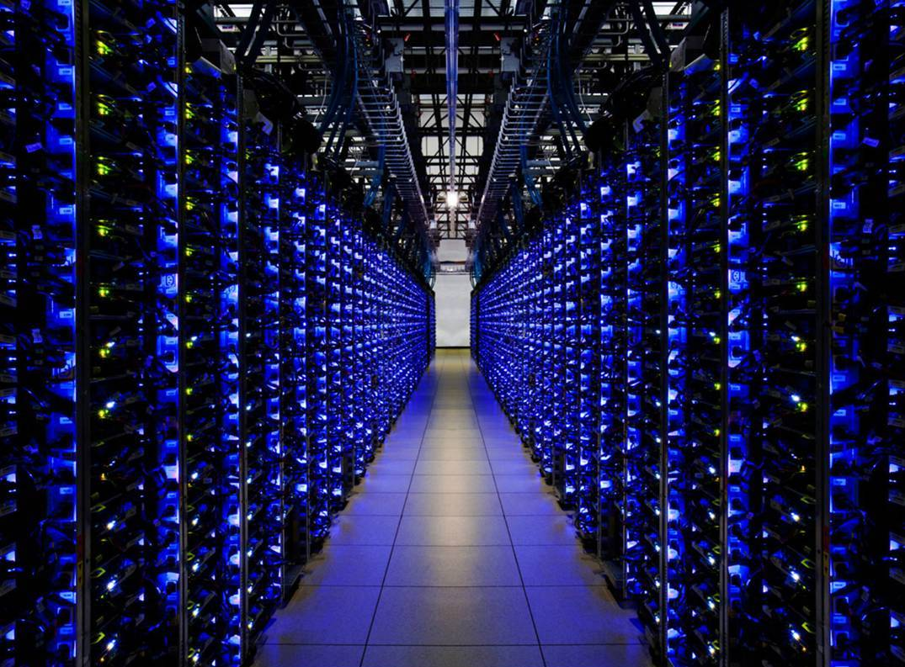
Server room

Slide 5
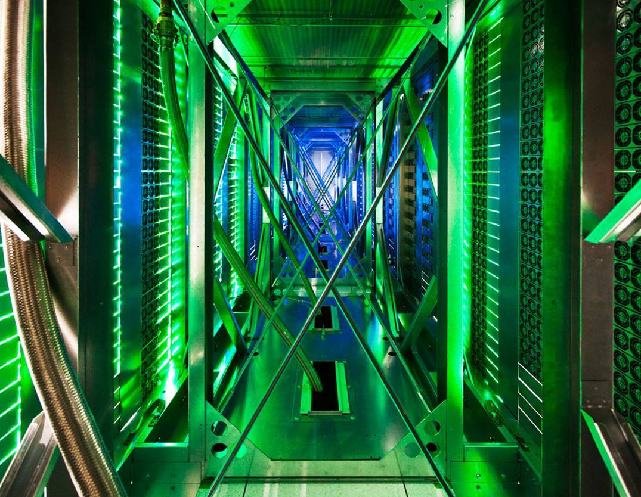
Behind servers, cooling fans - the green light comes from LEDs on the front of the servers.

Slide 6
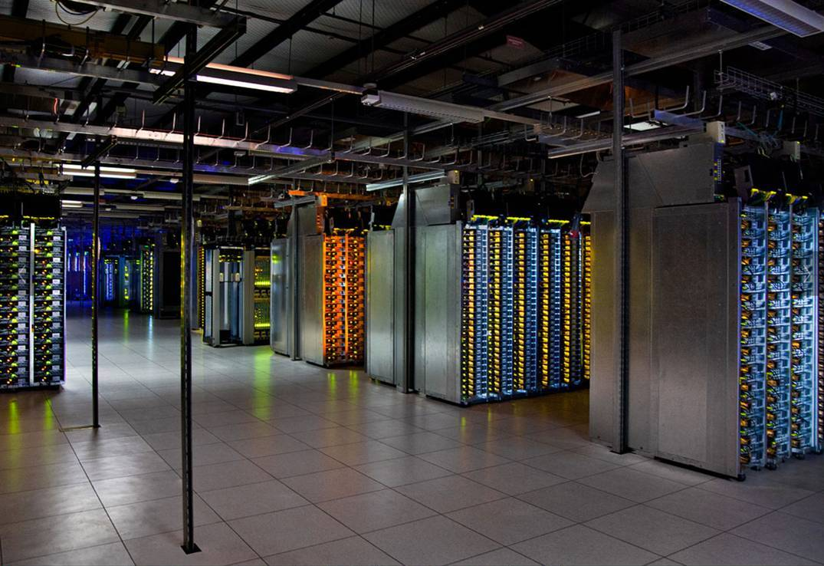
This room process data gathered around the world, the lighting is muted when the room is unoccupied, Then only LEDs illuminate.

Slide 7
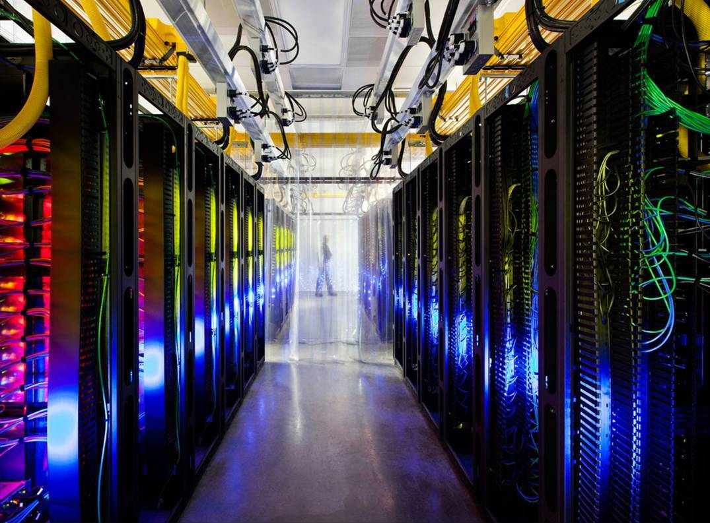
Routers are interconnected
by ultra fast optical fiber ( in yellow )

Slide 8
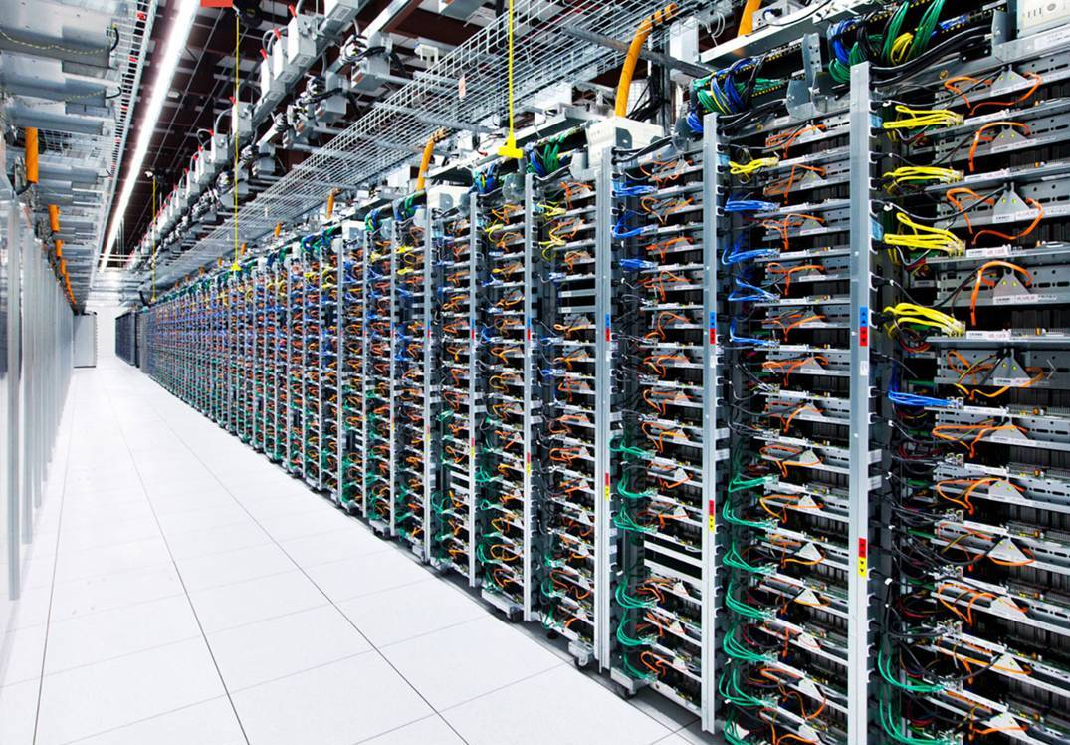
Another row of servers

Slide 9
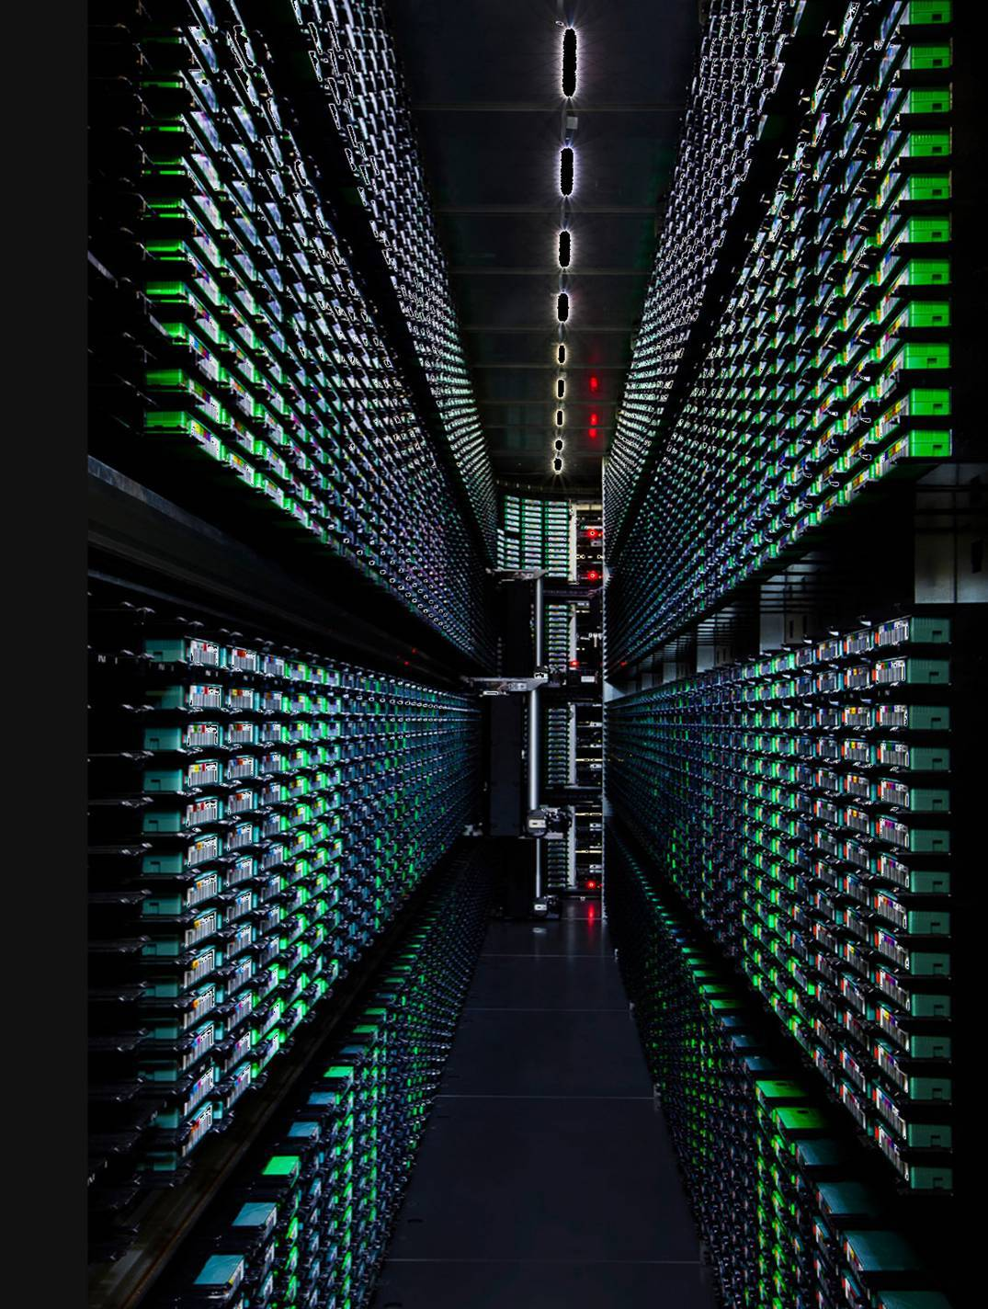
Robots for backuping and restoring data

Slide 10
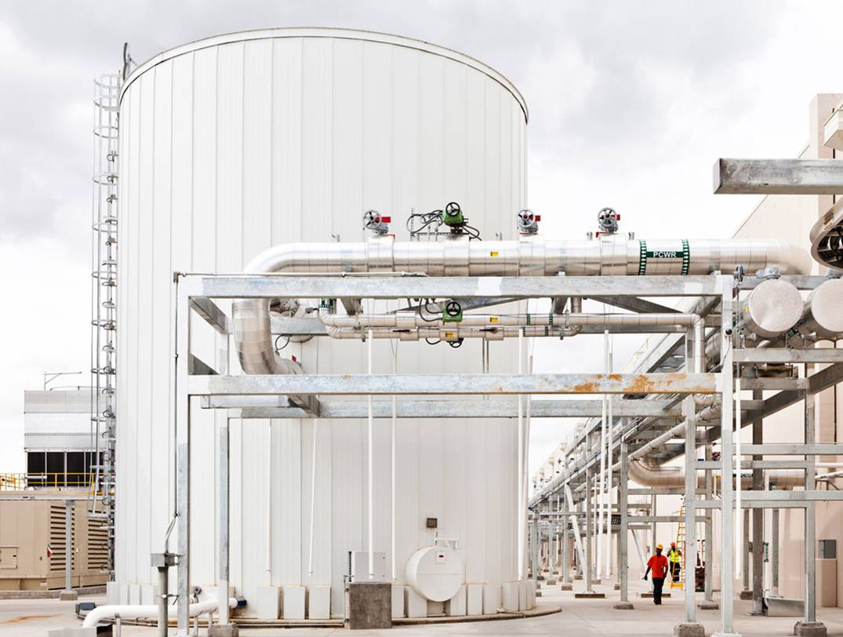
External cooling tank

Slide 11
